Slide 1
Weather Prediction using Ml Techniques
by shiv alashetty

Slide 2
Topics
1. Design
Architecture of the proposed System
Data Flow Diagrams
Use case diagrams
Sequence Diagrams
2. Implementation
Modules split up and explanation of each module
Algorithms used for each modules
Demonstration of working modules
Conclusion for project work phase-2 review-1
Action plan for project work phase-2 review-2

Slide 3
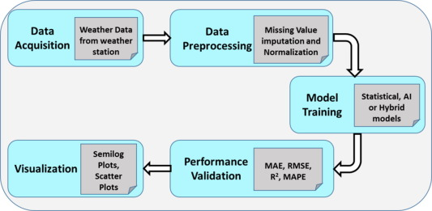

Slide 4
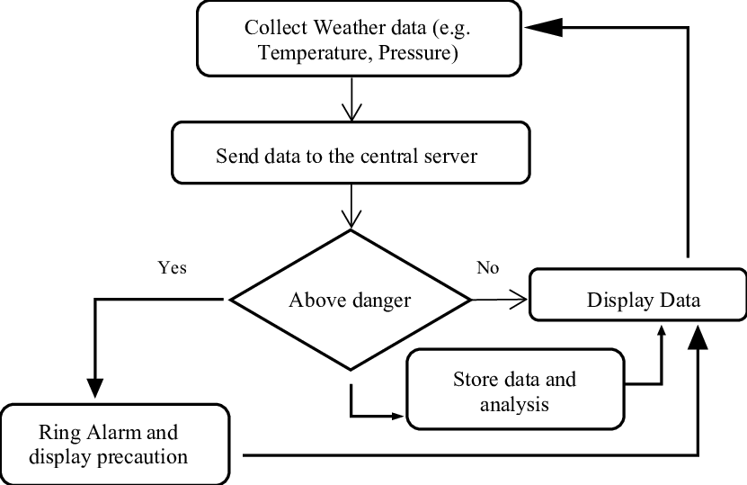
Data Flow Diagram to measure weather data

Slide 5
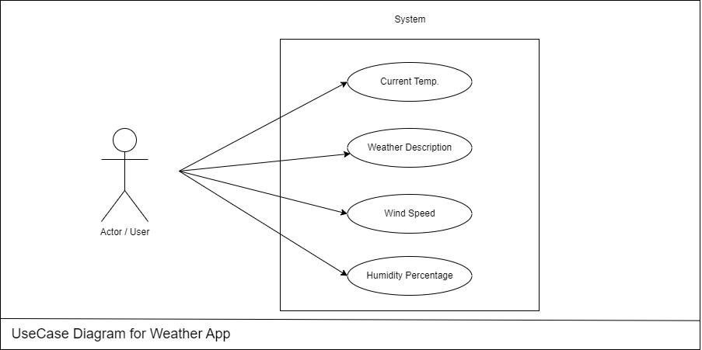
Use Case Diagram

Slide 6
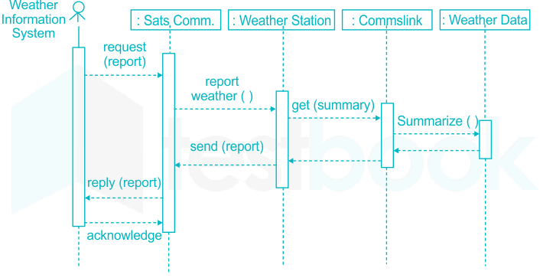
Sequence Diagram

Slide 7
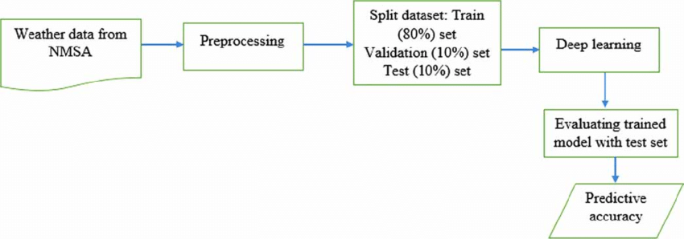
Proposed Model System
Delhi

Slide 8
Algorithms used for each modules
Model Approach | Contribution
Random Forest | Utilizes an ensemble of decision trees, robust against overfitting, captures complex nonlinear relationships in data.
Linear Regression | Provides interpretable linear relationships between input features and target variables, high predictive accuracy.
Support Vector | Utilizes support vector machines for regression, handles high-dimensional data, offers insights despite lower accuracy.
Gradient Boosting | Sequentially trains weak learners, corrects errors iteratively, achieves high accuracy in capturing underlying patterns.
Convolutional Neural Networks (CNN) | Proficient in extracting spatial and temporal features from data, often applied in image and signal processing tasks.
Long Short-Term Memory (LSTM) | Effective in capturing long-term dependencies in sequential data, suitable for time series forecasting tasks.
Artificial Neural Networks (ANN) | Offers flexibility in learning complex relationships in data, suitable for various forecasting tasks, high predictive accuracy.

Slide 9
Demonstration of working modules
Implementation Steps in Weather Prediction
Data Collection:
Gather historical weather data from reliable sources spanning a significant timeframe.
Include various meteorological parameters such as temperature, humidity, pressure, wind speed, and precipitation.
Data Preprocessing:
Cleanse the data to remove outliers, errors, and missing values.
Perform feature engineering to extract relevant features and enhance model performance.
Normalize or standardize the data to ensure uniformity across different features.
3. Model Selection:
Choose appropriate machine learning and deep learning models based on the nature of the problem and available data.
Consider models such as Random Forest, Linear Regression, Support Vector Regression, Convolutional Neural Networks (CNN), Long Short-Term Memory (LSTM), and Artificial Neural Networks (ANN).

Slide 10
4. Model Training:
Split the dataset into training, validation, and testing sets.
Train the selected models using the training data while validating performance on the validation set.
Fine-tune hyperparameters through techniques such as grid search or random search to optimize model performance.
5. Model Evaluation:
Assess model performance using evaluation metrics such as Mean Squared Error (MSE), Mean Absolute Error (MAE), and R-squared (R2) score.
Compare the performance of different models to identify the most effective approach.

Slide 11
Applications of Weather Forecasting System
Agriculture: Optimize crop yields and minimize losses by planning planting, irrigation, and harvesting schedules based on accurate weather forecasts.
Energy Management: Anticipate fluctuations in energy demand and optimize production schedules in response to weather conditions such as wind speed and heatwaves.
Transportation: Improve safety and minimize delays by planning routes and operations for airlines, shipping companies, and logistics firms based on weather forecasts.
Disaster Management: Proactively prepare for and respond to natural disasters such as hurricanes, wildfires, and floods with early warnings and resource allocation based on weather forecasts.
Tourism and Outdoor Activities: Enhance leisure planning for travelers and outdoor enthusiasts by providing forecasts of weather conditions such as rain, snow, and extreme temperatures.
Construction and Infrastructure: Prevent delays and ensure worker safety in construction projects by adjusting work plans based on forecasts of inclement weather.

Slide 12
Action Plan for Phase-2 Review-2:
Consolidate findings from the exploration and analysis of historical weather data and document key trends and patterns identified. Conducted a detailed comparative analysis of machine learning models and deep learning models, highlighting their strengths and weaknesses in weather forecasting. Refined model evaluation procedures to ensure comprehensive assessment of accuracy and effectiveness using appropriate evaluation metrics. Identified limitations or challenges encountered during the implementation phase and propose potential solutions or alternative approaches. Prepared a comprehensive report summarizing the progress made during Phase-2 and outlining the next steps for Phase-3 of the project

Slide 13
Action plan for project work phase
Task/Week | Week 1 | Week 2 | Week 3 | Week 4 | Week 5 | Week 6 | Week 7 | Week 8 | Week 9 | Week 10
Task 1 |  | Project Selection
Task 2 |  |  | Literature Survey
Task 3 |  |  |  | Project Design
Task 4 |  |  |  |  | Implementation Phase1
Task 5 |  |  |  |  |  | Testing1
Task 6 |  |  |  |  |  |  | Implementation phase 2
Task 7 |  |  |  |  |  |  |  | Testing 2
Task 8 |  |  |  |  |  |  |  |  | Final Testing
Task 9 |  |  |  |  |  |  |  |  |  | Document
Task 10 |  |  |  |  |  |  |  |  |  | Presentation

Slide 14
Thank You

